Slide 1
Futsal Field Reservation System
Developed By:
Ehtisham Naveed
CK-FA-21-110734
Saadullah
CK-FA-21-110420s
Supervised By:
Mam Nazish Bashir
Program:
Computer Science
Session:
Fall 2021 to Spring 2025
Department of Computing & Technology
Iqra University Islamabad Campus (Chak Shahzad)

Slide 2
Contents
Introduction
Problem description
Proposed Solution
Aims and Objectives
Modules and Methodology
Feasibility analysis
Prototype
Question Answer session

Slide 3
Introduction
Transforming football experiences in Rawalpindi and Islamabad.
Our innovative platform simplifies futsal ground bookings, saving time and effort for local teams. We enable seamless scheduling, connect players, and support ground owners in managing facilities efficiently.
With added features like football academies and a donation system for underprivileged players, we are dedicated to fostering accessibility and professionalism in local football.

Slide 4
Problem Description
Challenges in Booking Football & Futsal Grounds in Pakistan
Currently, players in Pakistan face a tedious, time-consuming process to book futsal and football grounds, with no central hub to streamline reservations. They must call multiple ground owners, wasting time and energy. Even when a slot is secured, finding opponents can be difficult.
For ground owners, this leads to mismanagement, sporadic bookings, and lost revenue. Aspiring players, particularly from underprivileged backgrounds, struggle to access training and facilities. These barriers hinder the growth of football culture and local community involvement.

Slide 5
Proposed Solution
Our platform simplifies futsal ground booking and facility management, providing ground owners with an easy way to list available slots, streamline reservations, and increase revenue.
Players can search, book, and arrange matches without the need to contact multiple ground owners.
Additional features include academy registration for all ages to enhance skills and a donation system to support underprivileged players.
By addressing the needs of both players and owners, this system improves access to football, promotes local sporting ecosystems, and fosters a more professional, organized environment for the game.

Slide 6
Aims and Objectives
Aim:
The aim of the Futsal Field Reservation System is to simplify the process of booking futsal grounds and managing facilities for both players and ground owners. By offering a centralized, user-friendly platform, the project aims to enhance accessibility, promote football culture, and create a more efficient, profitable business model for ground owners.
Objectives:
1.Simplify the Booking Process
2.Optimize Facility Management
3.Promote Football Culture & Skill Development
4.Support & Scalability

Slide 7
Methodology
Agile Methodology: The project will use an iterative and flexible development approach to ensure continuous feedback and improvement.
Iterative Development: The project is divided into manageable cycles (sprints), each delivering a specific set of features.
Stakeholder Collaboration: Regular communication with players, ground owners, and administrators to gather feedback and refine features.
Frequent Testing: Each sprint includes testing to ensure the platform’s functionality and quality.
Faster Delivery: Prioritization of high-impact features, such as ground booking and team coordination, for early delivery.

Slide 8
Algoritham
User Registration & Authentication
Ground Listing & Search
Booking Process
Match Coordination
Payment & Donations
Notifications & Updates
Admin & Ground Owner Panel

Slide 9
Cont..
Compliance and regulation:
The project will adhere to relevant local regulations, data protection laws, and industry best practices to ensure compliance and secure operations.
Launch:
Prepare for a successful Futsal field reservation system.
Tools:
Html, CSS, JavaScript
Node js
SQL/MONGODB

Slide 10
Cont..
Data Collection:
It will involve conducting interviews with football players and ground owners to identify pain points and feature preferences. Additionally, focus groups will be organized to gather insights on desired functionalities, while competitor analysis will be conducted to benchmark against similar platforms for best practices.
Front-End Design:
After collecting data from football players, ground owners, and stakeholders, we will proceed to design the frontend for the Futsal Field Reservation System.
We will utilize tools like HTML, CSS, JavaScript, and ReactJS to create a dynamic and interactive interface. Additionally, Figma will be used to design wireframes and rough layouts of the platform.
The frontend will feature a user-friendly interface with consistent colors, interactive elements like buttons, booking forms, and search bars to ensure seamless navigation and ease of use for both players and ground owners.

Slide 11
Cont..
Backend:
In the backend step, we will use Node.js and Express.js to handle server-side logic and manage user requests efficiently.
MongoDB will serve as the database to store and manage unstructured data such as user profiles, bookings, and ground information.
The backend will facilitate features like user authentication, ground booking management, team coordination, and donation processing.
The system will also ensure smooth integration between the frontend and backend, with secure handling of data and real-time updates for users.

Slide 12
Feasibility Analysis
Technical Feasibility:
We have the technical skills to develop Futsal Field Reservation using HTML, CSS, java script and MySQL. Our expertise and open source tools make our project technically feasible.
Operational Feasibility:
This looks at whether the system can be used effectively within the futsal ground environment and if it can be maintained smoothly over time.
Economical Feasibility:
All the tools used in our project are open source there is no need to buy anything from somewhere. this make us our project economically feasible

Slide 13
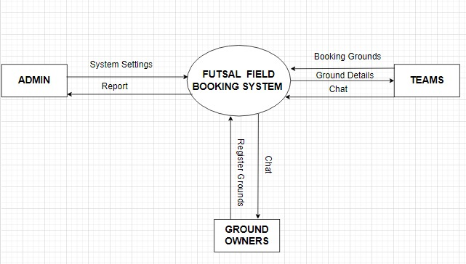
Use Case Diagram

Slide 14
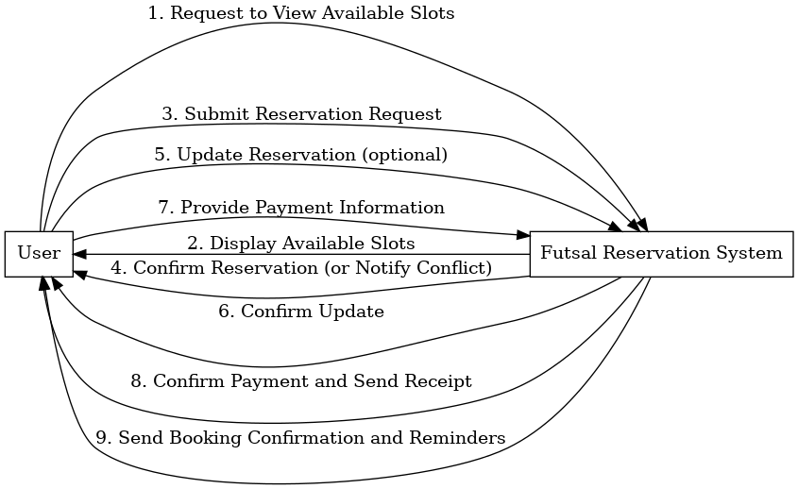
System Sequence Diagram
Diagram:

Slide 15
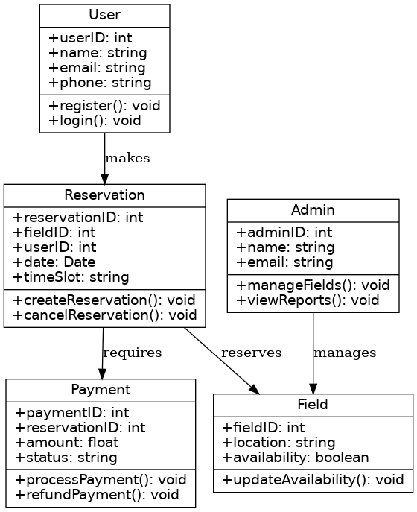
Class Diagram
Diagram:

Slide 16
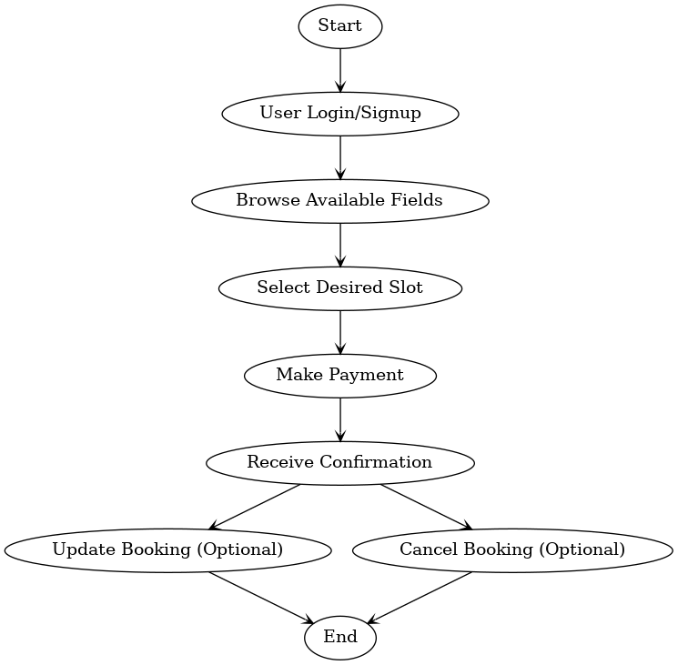
Activity Diagram
Diagram:

Slide 17
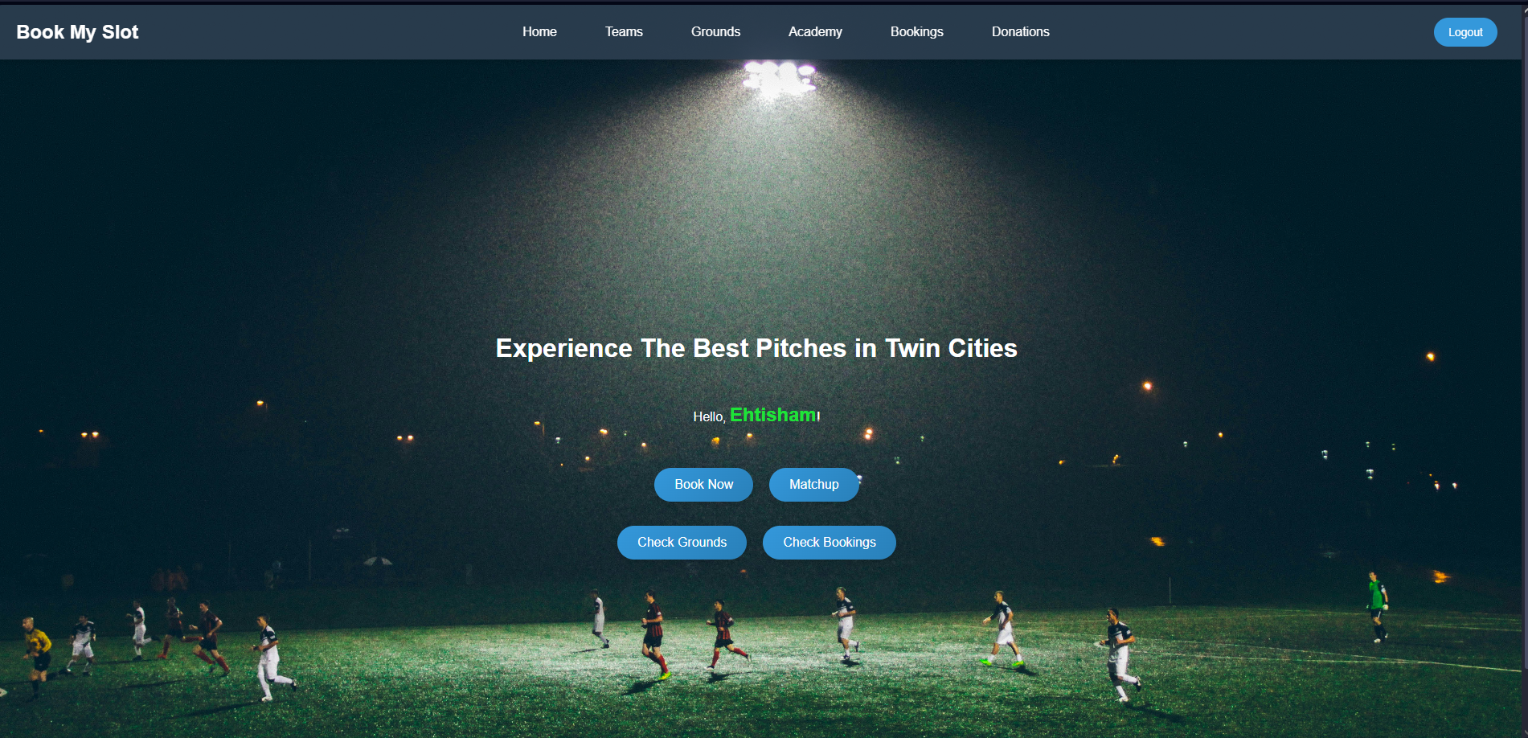
Prototype
Dashboard:

Slide 18
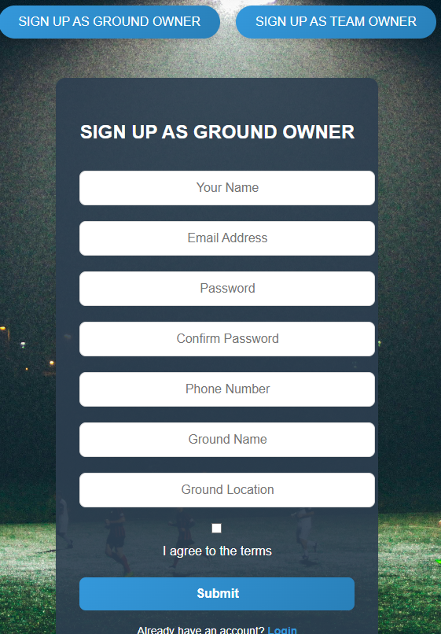
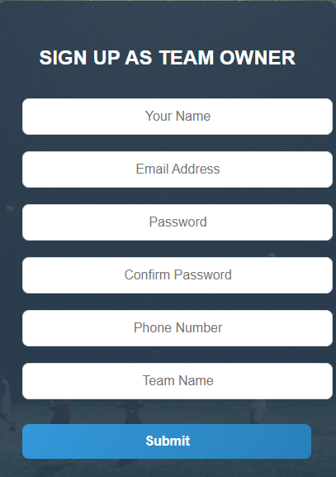
Signup(Ground Owner/ Team) Dashboard

Slide 19
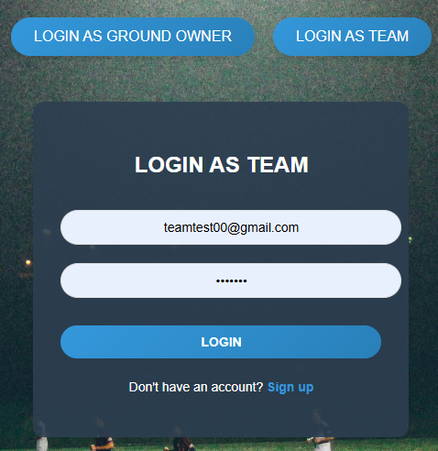
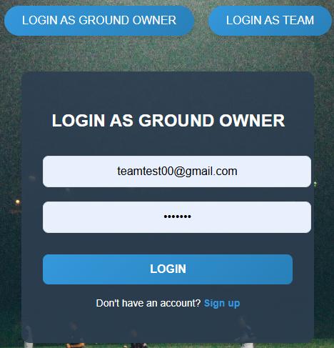
LOGIN(Ground Owner/Team) Dashboard

Slide 20
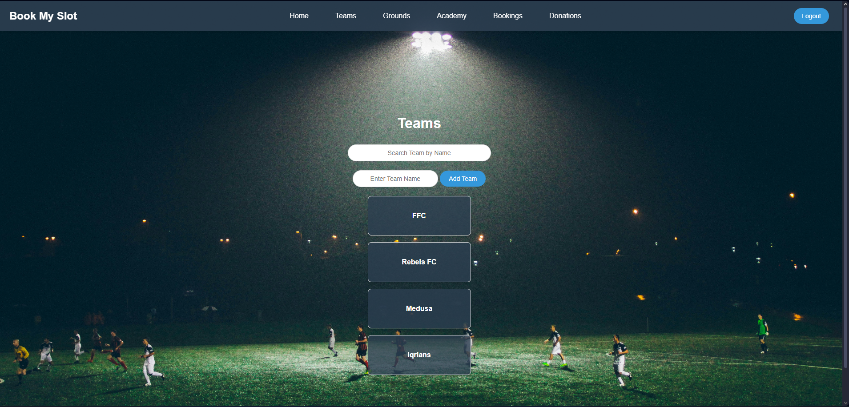
Teams Dashboard

Slide 21
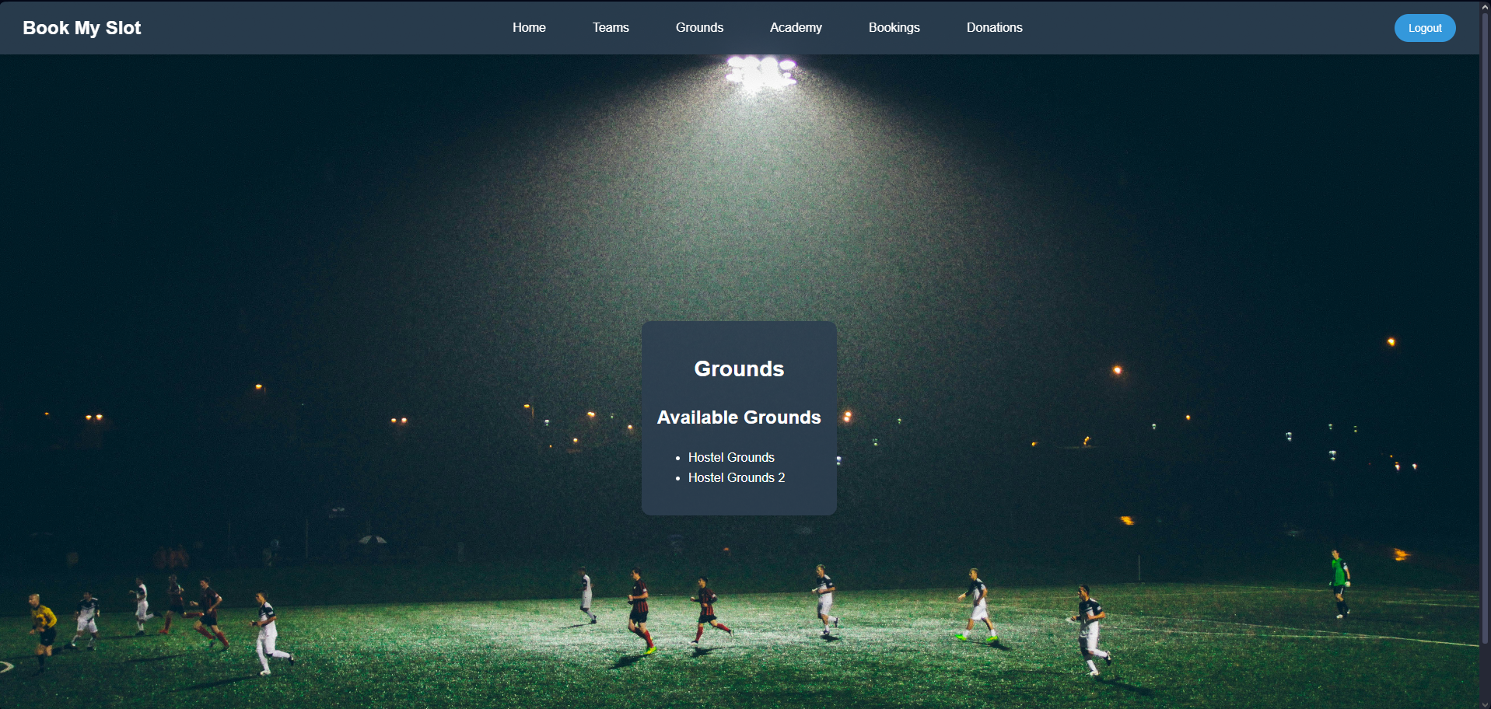
Ground Dashboard(login as Team Owner)

Slide 22
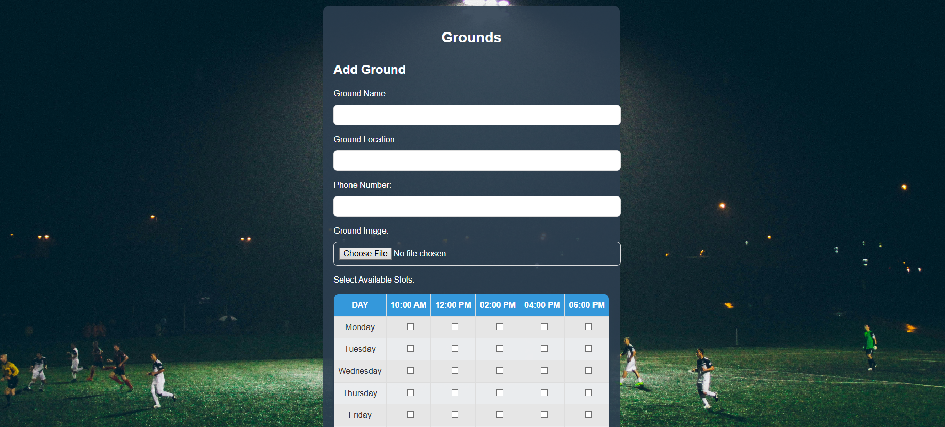
Ground Dashboard(login as Ground Owner)

Slide 23
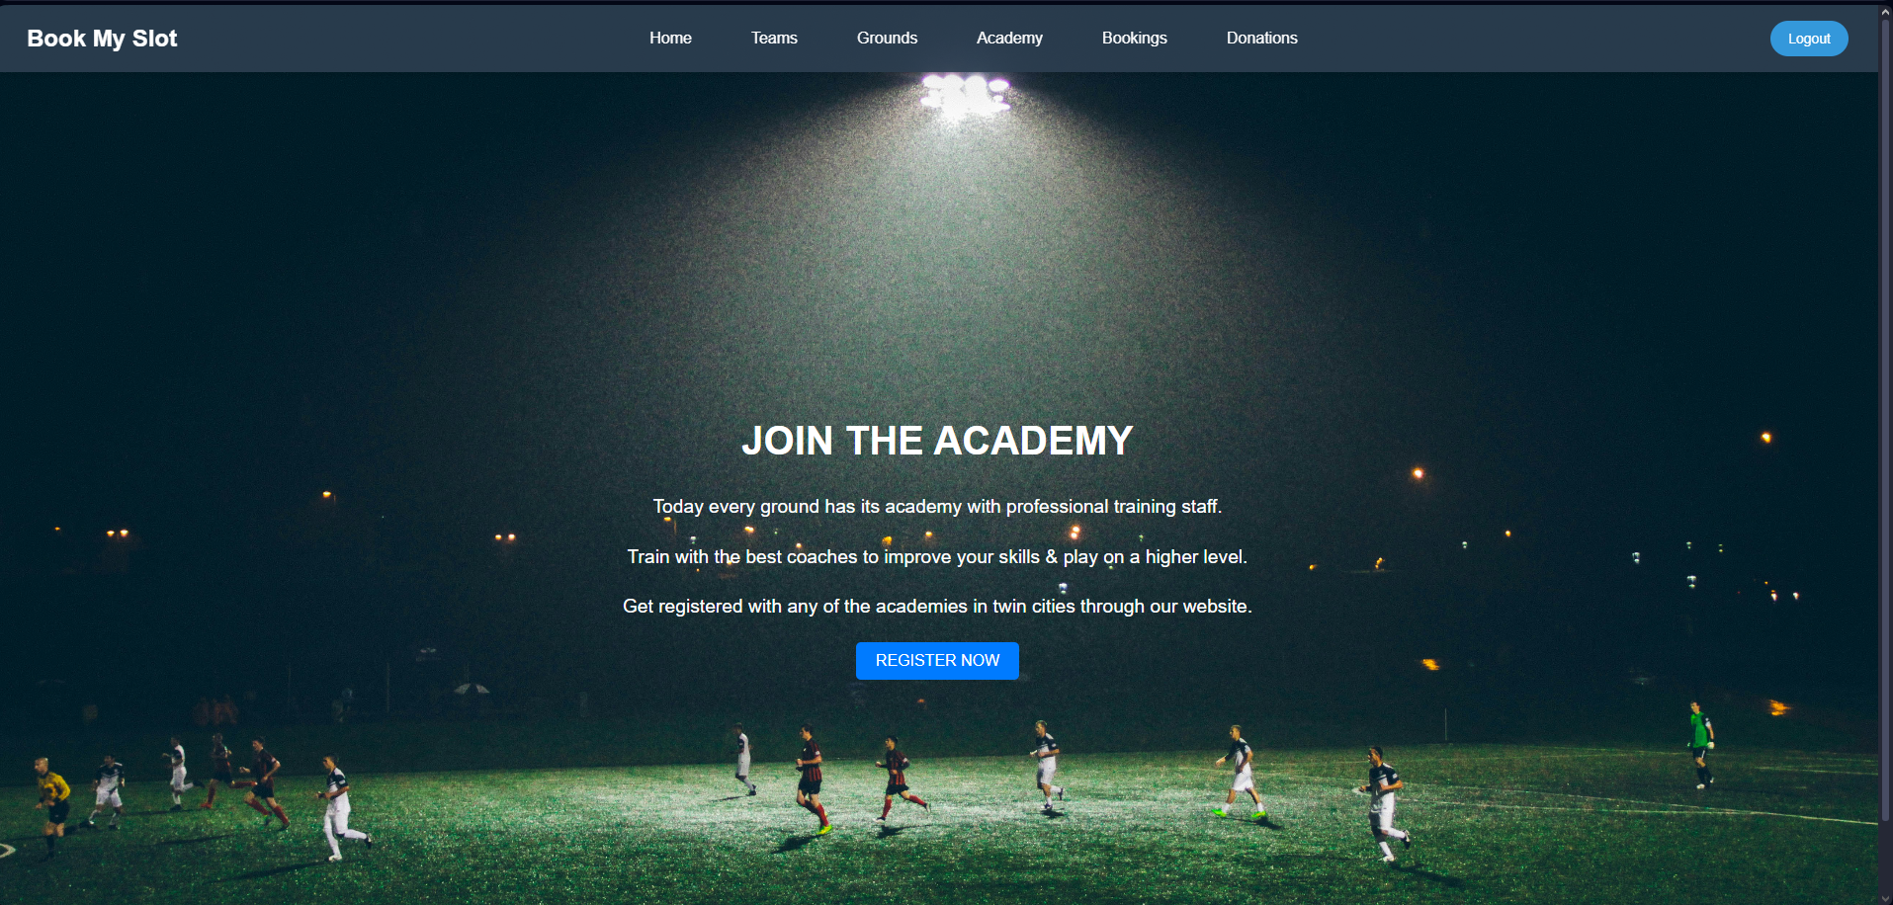
Academy Dashboard

Slide 24
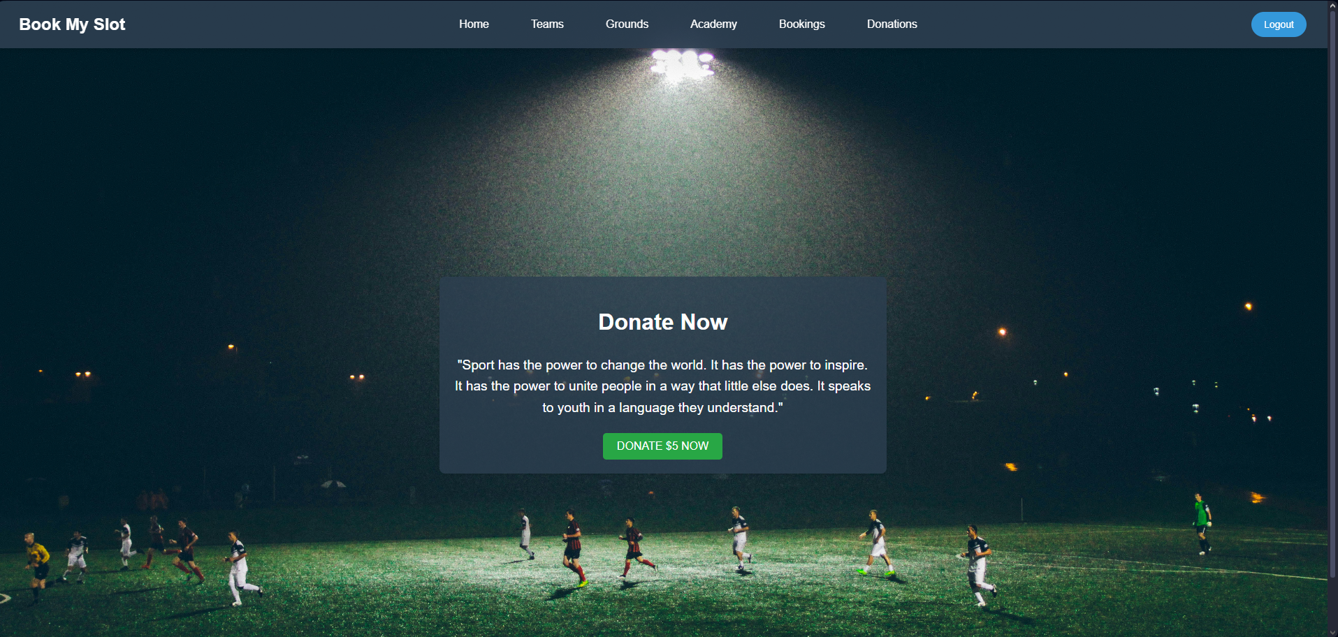
Donation Dashboard

Slide 25
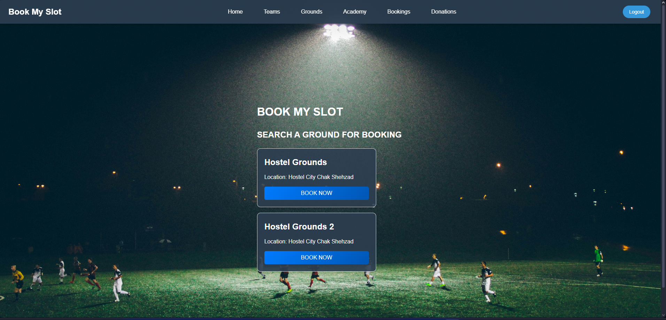
Bookings

Slide 26
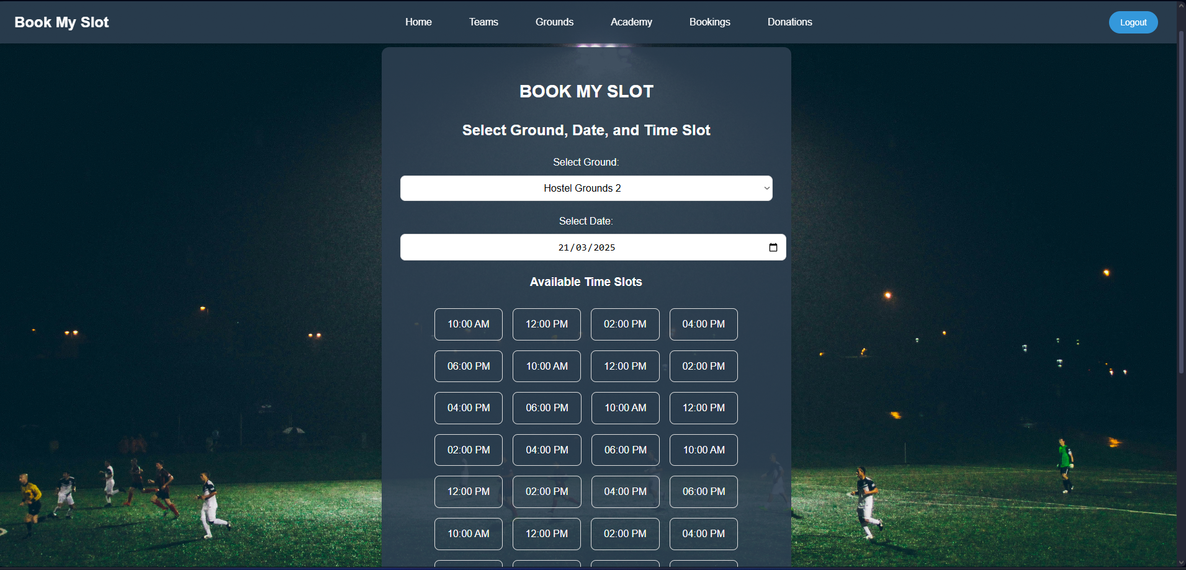
Slots Timing / Available Slots

Slide 27
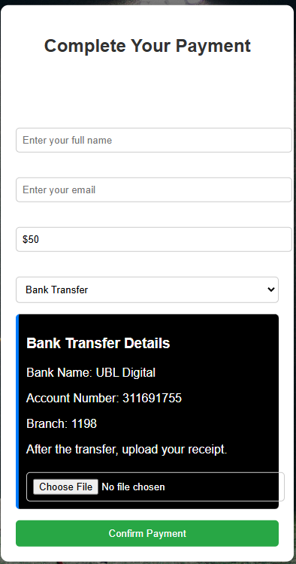
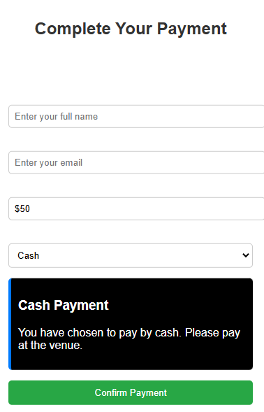
Payment Option

Slide 28
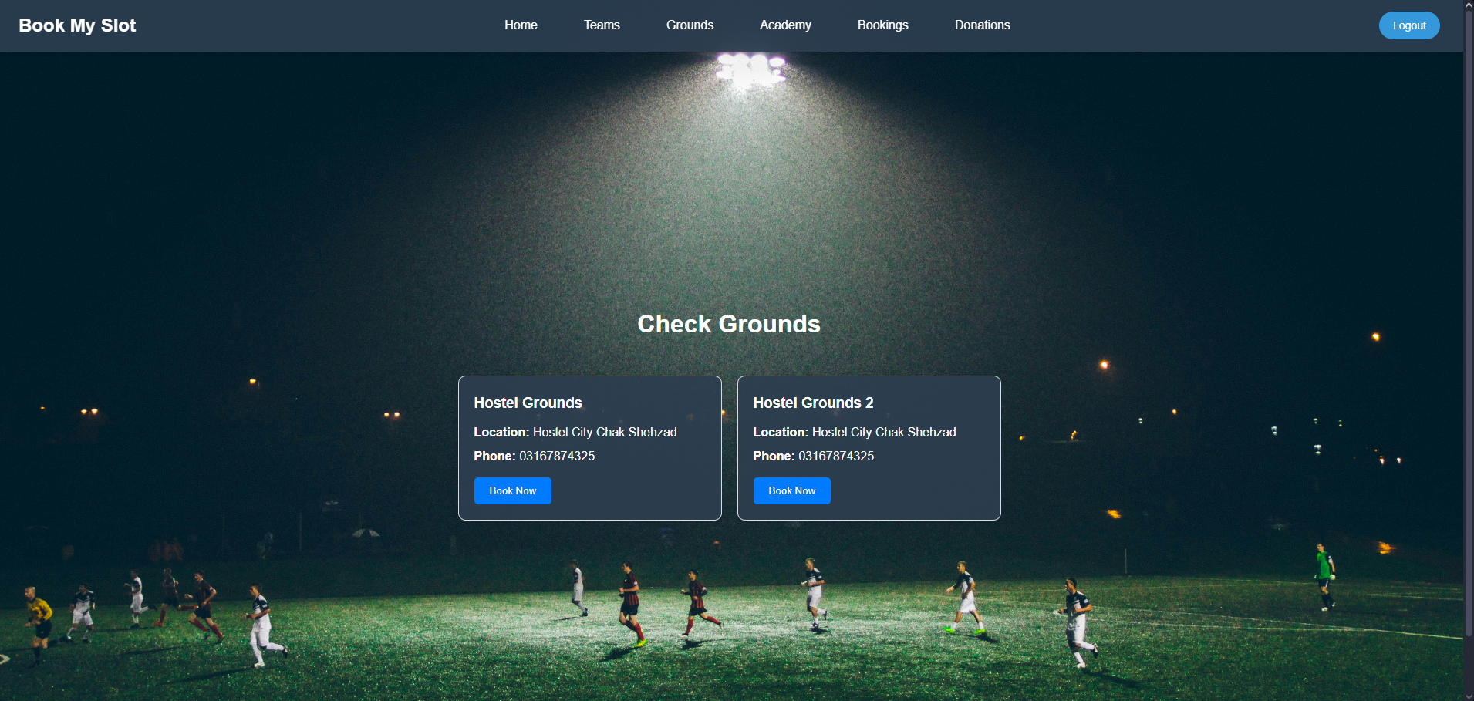
Check Grounds

Slide 29
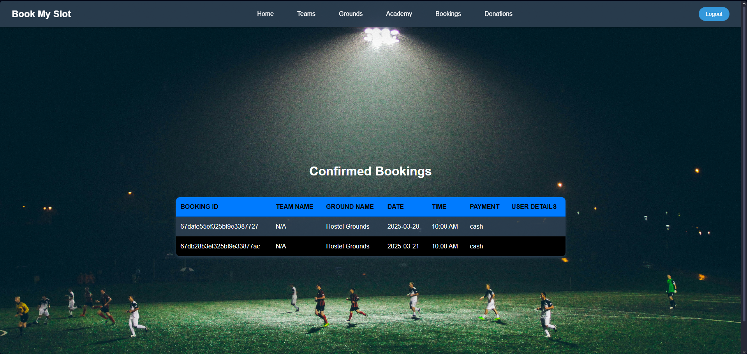
Check Bookings

Slide 30
Any Questions?

Slide 31
THANK YOU

